Slide 1
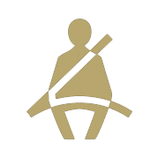
Statewide Safety Belt Use Rates
For more information, contact Katie Womack, kwomack@tamu.edu.
1

Slide 2
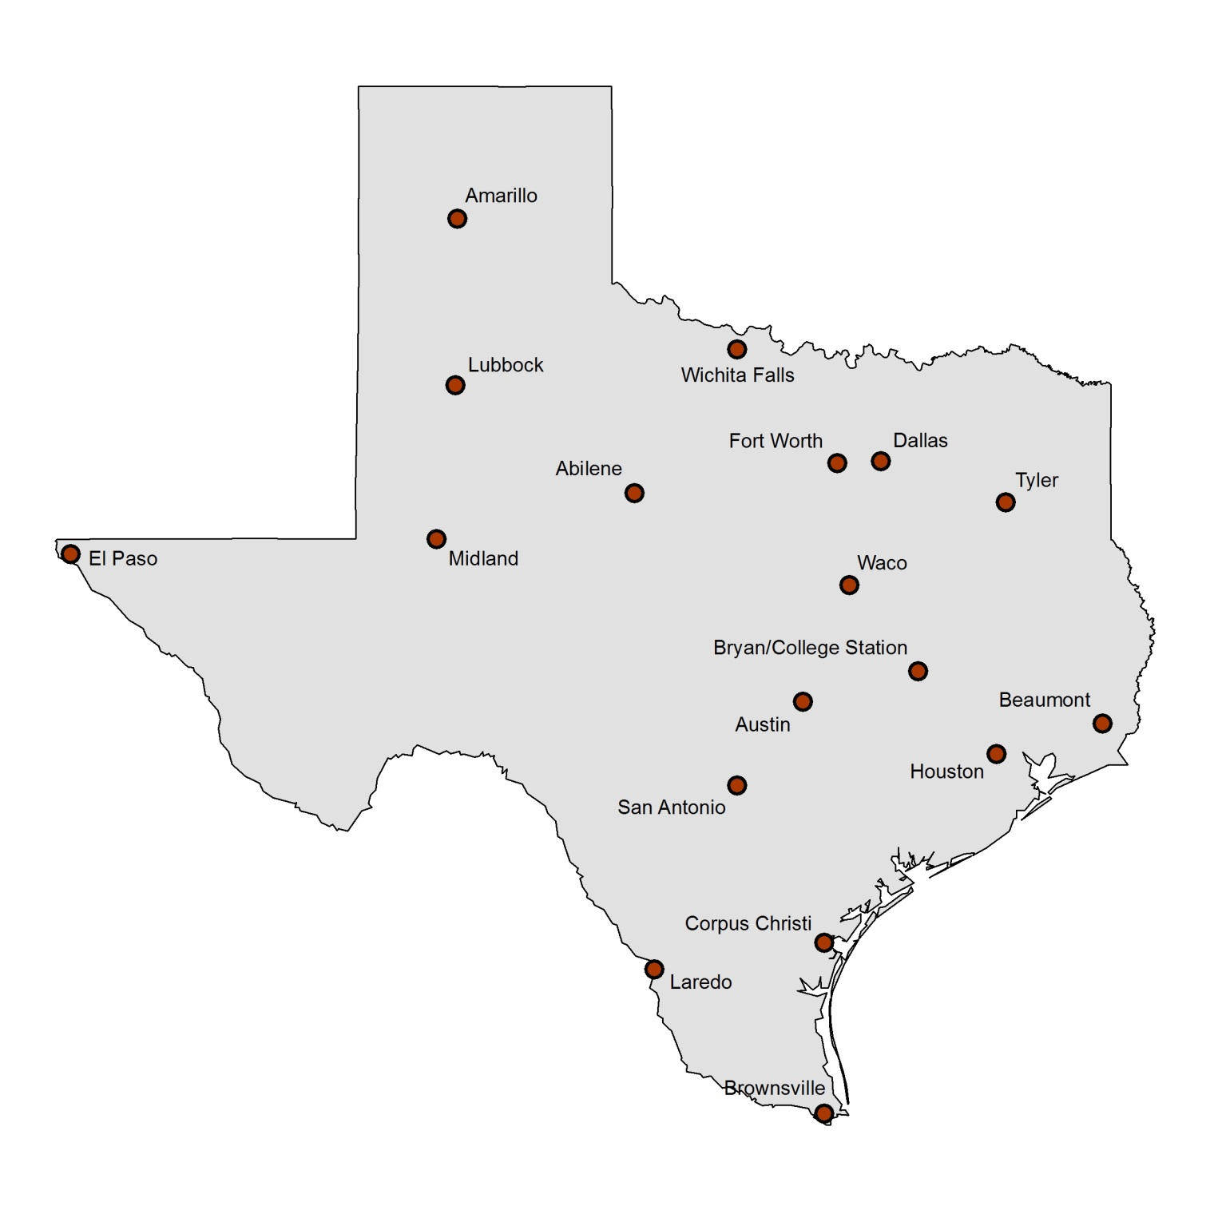
Texas 2017 Safety Belt Use by City
Use is for driver and front seat outboard passenger. Total sample size = 26,434 occupants in 21,600 vehicles (1,200 per city). Average estimate across cities of total restraint use is 90.1%. Drivers were seat belted at a rate of 90.3% and passengers at a rate of 89.3%.
90.5%
89.2%
93.4%
89.0%
87.0%
88.1%
90.1%
92.9%
88.7%
90.1%
90.3%
86.0%
95.3%
90.1%
90.1%
91.0%
89.2%
91.7%
For more information, contact Katie Womack, kwomack@tamu.edu.
2

Slide 3
Texas 2017 Nighttime Safety Belt Use by City
Use is for driver and front seat outboard passenger combined. Total sample size = 23,307 occupants. Average estimate across cities of total nighttime restraint use is 85.2%. Drivers were seat belted at a rate of 85.1% and passengers at a rate of 85.6%.
81.6%
83.7%
82.0%
86.3%
78.8%
79.9%
86.8%
91.9%
81.9%
86.9%
91.9%
91.3%
83.0%
83.7%
86.8%
85.8%
81.7%
85.7%
For more information, contact Katie Womack, kwomack@tamu.edu.
3

Slide 4
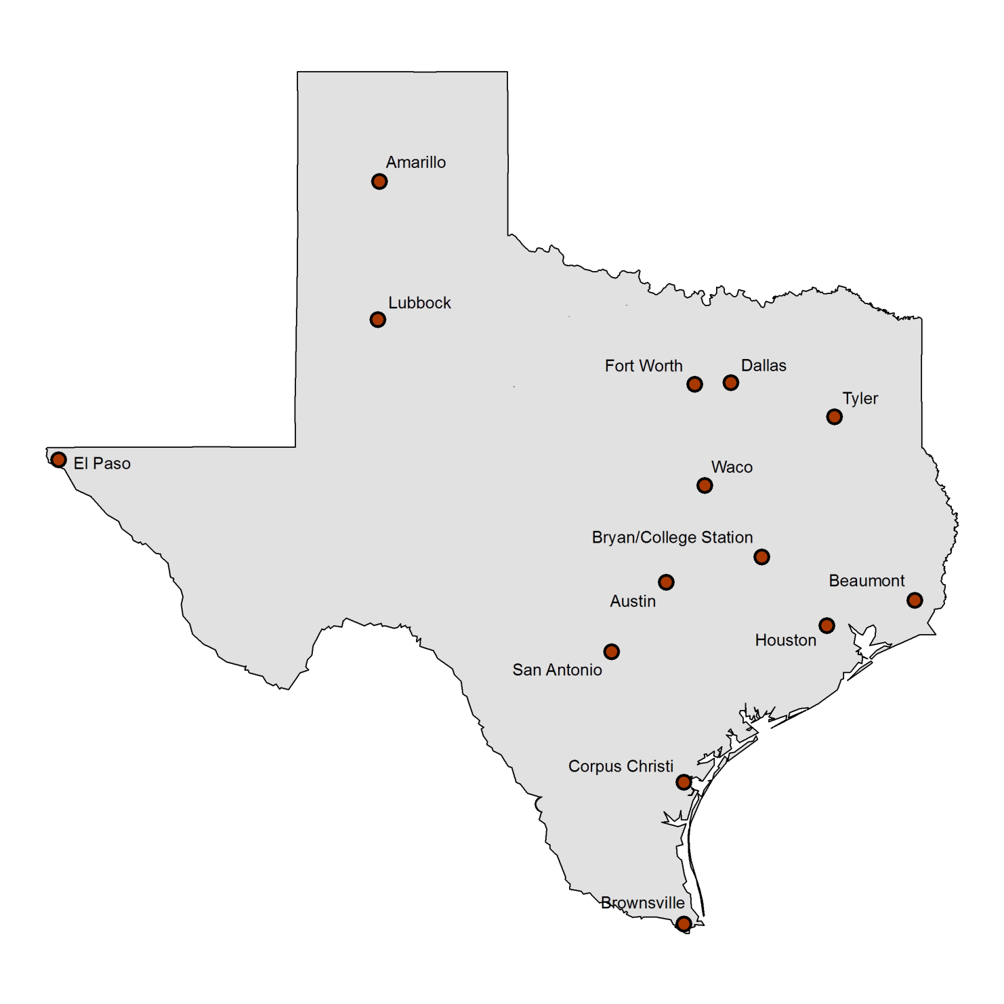
2017 Child Restraint Use in 14 Texas Cities
Surveys conducted at child care centers and shopping center entry points. Children estimated as 4 years old and younger included in the sample. Total sample size = 13,656. Average estimate across cities of total restraint use is 87.4%.
86.6%
87.8%
82.5%
90.6%
92.5%
88.9%
82.6%
92.8%
95.2%
85.6%
85.3%
89.4%
83.9%
77.5%
For more information, contact Katie Womack, kwomack@tamu.edu.
4

Slide 5
2017 School-Age Child Restraint Use in 18 Texas Cities
Surveys conducted in or near school zones in four quadrants in each city, with a quota sample of a minimum of 500 vehicles/city. Total 2017 sample size = 12,183. Children estimated as 5-16 years old included in the sample. Average percent use across all cities = 57.8%.
57.5%
59.7%
79.6%
57.6%
50.7%
64.1%
65.1%
70.7%
71.1%
41.6%
73.2%
47.6%
59.1%
43.9%
49.6%
52.4%
47.6%
57.0%
For more information, contact Katie Womack, kwomack@tamu.edu.
5

Slide 6
Statewide Motorcycle Helmet Use Rates
% Helmet Use
For more information, contact Katie Womack, kwomack@tamu.edu.
6

